Slide 1




BDM Capstone Project
Enhancing Profitability and Efficiency at Khai Khajani House: A Data-Driven Analysis of Sales and Operations in Dumartarai Wholesale Market
by Riya Chandrabel [ 22f3003173 ]

Slide 2
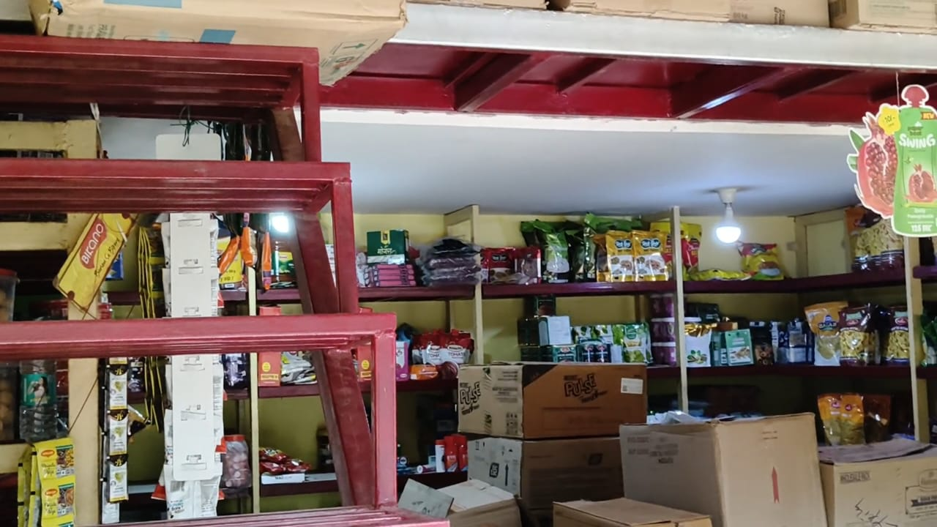
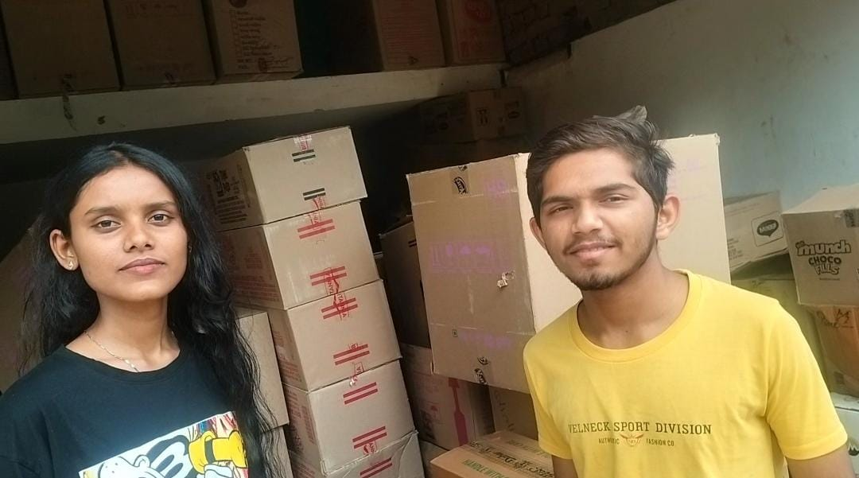
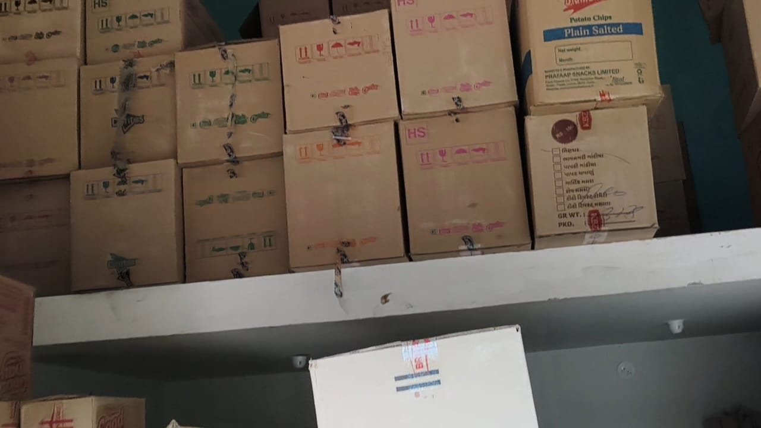
The Business and The Problems
About the Business
Name of the Business: Khai Khajani House
Type of Business: B2B confectionery wholesale business
Location: Dumartarai Wholesale Market, Raipur, Chhattisgarh, India – PIN 492015.
Founder: Mr. Aditya Sharma
Background: Established in December 2023 by Aditya Sharma, the company focuses on delivering high-quality products at competitive prices, ensuring retailers and wholesalers can efficiently meet consumer demand.
Problems
Inventory Imbalance: Over/understocking of products due to inconsistent demand.
Ineffective Discounting: Discounts are not aligned with customer revenue contribution, leading to profit leakage.
Data Collection
Collected 389 transaction records from Jan 1 to Apr 6, 2024, including details like Invoice ID, Product, Customer Type, Quantity, Price, Discount, Revenue, and Payment Mode.
Data was cleaned and validated using Excel and Python, ensuring accuracy by recalculating revenue for each transaction and confirming there were no missing values.

Slide 3

Data Cleaning and Preprocessing
Before going ahead with the analysis part it was necessary to clean and preprocess the data. A series of preprocessing operations were carried out on the dataset making the data eligible for the data analysis operations.
🧹
🏷️
📊
🧮
📌
Data
Cleaning
Customer & Payment Label Standardization
Revenue Validation
Data Type Formatting
Outlier Flagging
Unusually high or low transaction values were identified (e.g., INV100085 = Rs. 9100) and flagged for further insight.
Rectified revenue errors and inconsistent data formats.
Customer types and payment modes were standardized for uniform classification.
Recalculated revenue for data accuracy.
Converted columns to correct data types.

Slide 4






Objective and the Methods
Objective: The aim of the project is to Enhance profitability and efficiency at Khai Khajani House by using data-driven analysis to optimize inventory, streamline payments, and align discount strategies with customer value. Identify and address operational bottlenecks to support sustainable business growth
Methods of Analysis: Following rigorous data cleaning and preprocessing, five core analytical methods were deployed to uncover insights across sales categories, product performance, customer behavior, and future trends at Khai Khajani House
Descriptive Analysis
Trend Analysis
Segmentation Analysis
Profitability Analysis
Statistical Inference
Descriptive Analysis summarizes sales metrics using mean, median, and standard deviation
To identify sales patterns, forecast demand, and optimize inventory planning
Customer and product segmentation revealing that wholesalers and retailers contributed over 50% of total revenue
Discount impact assessment showing hotels received highest discounts (10.7%) despite lower revenue contribution
T-tests, ANOVA, and correlation analysis to validate findings and relationships between variables

Slide 5

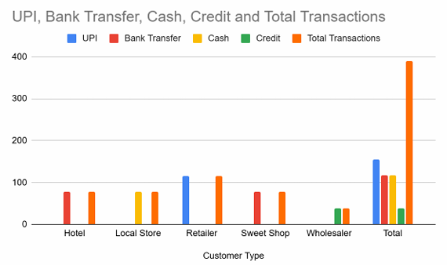
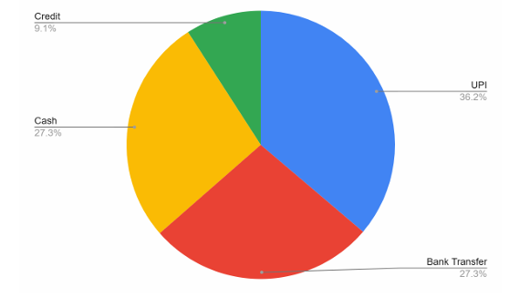
ANALYSIS 1
Transaction Distribution by Customer Type and Payment Mode
Explanation
This analysis examined how different types of customers (Retailers, Hotels, Wholesalers, etc.) prefer specific payment modes (UPI, Credit, Bank Transfer, Cash).
Results and Findings
Retailers had the highest number of transactions (116), all done via UPI, showing a strong preference for digital payments.
Hotels and Sweet Shops each made 78 transactions using Bank Transfer, indicating formalized and possibly bulk ordering processes.
Local Stores also recorded 78 transactions but used Cash exclusively, highlighting limited digital adoption.
Wholesalers had the fewest transactions (39), but all were high-value and paid via Credit, reflecting bulk purchasing and deferred payment terms.
Conclusion
Each customer type has a clear payment preference. UPI is the most widely used overall (39.8% of transactions). This insight supports efforts to promote digital payments and streamline credit invoicing.

Slide 6
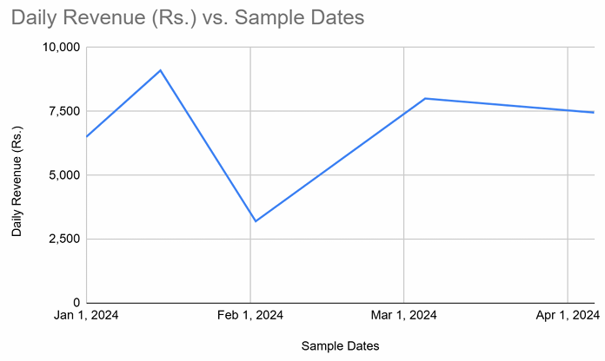
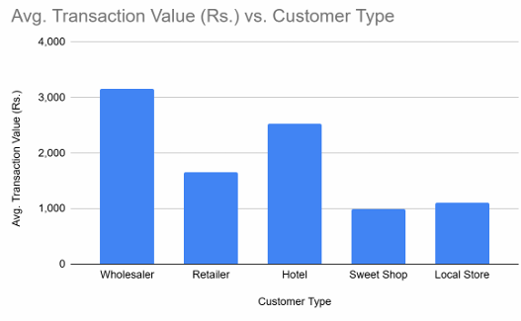
ANALYSIS 2
Daily Revenue Trend Analysis
Explanation
This time-series analysis tracked daily revenue from Jan 1 to Apr 6, 2024, highlighting fluctuations in sales and identifying peak revenue days.
Average daily revenue: Rs. 7,270
High spikes were linked to bulk orders by Wholesalers (e.g., invoice INV100085).
Low-revenue days mostly came from small cash-based buyers like Local Stores.
Results and Findings
Total revenue over 90 days was Rs. 654,325.50, with an average daily revenue of Rs. 7,270.
Sharp revenue spikes occurred on specific days (e.g., Day 15 and Day 34), driven by bulk orders from Wholesalers.
Low-revenue days were often linked to smaller transactions from Retailers and Local Stores.
The trend shows a cyclical pattern, indicating recurring high-demand periods.
Conclusion
Revenue is highly influenced by bulk buyers. Time-series forecasting can help anticipate peak demand, optimize inventory and staff planning, and introduce targeted promotions on slower days.

Slide 7
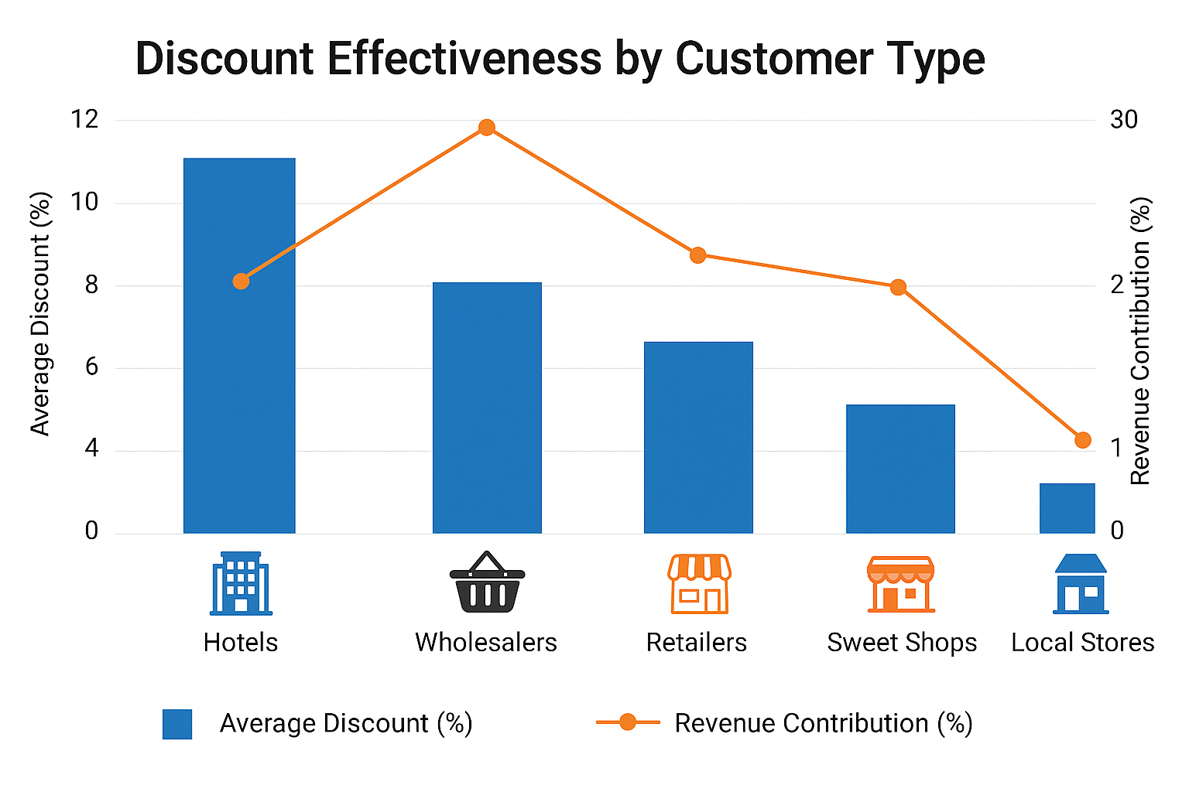
ANALYSIS 3
Discount Effectiveness by Customer Type
Explanation
This analysis evaluated how discounts were distributed across customer types and whether those discounts translated into meaningful revenue contributions. It aimed to identify whether current discount policies are aligned with actual business value generated by each customer group.
Results and Findings
Hotels received the highest average discount of 10.7%, yet their revenue contribution was lower compared to other customer types.
Wholesalers received no discounts at all, but contributed the highest percentage of total revenue (27.7%), indicating that they already offer value through bulk orders without needing additional incentives.
Retailers and Sweet Shops received moderate or no discounts and still maintained steady transaction volumes and revenue.
Conclusion
There is a misalignment between discounts and customer value. High-discount segments like Hotels are less profitable, while high-revenue segments like Wholesalers receive no incentives.

Slide 8
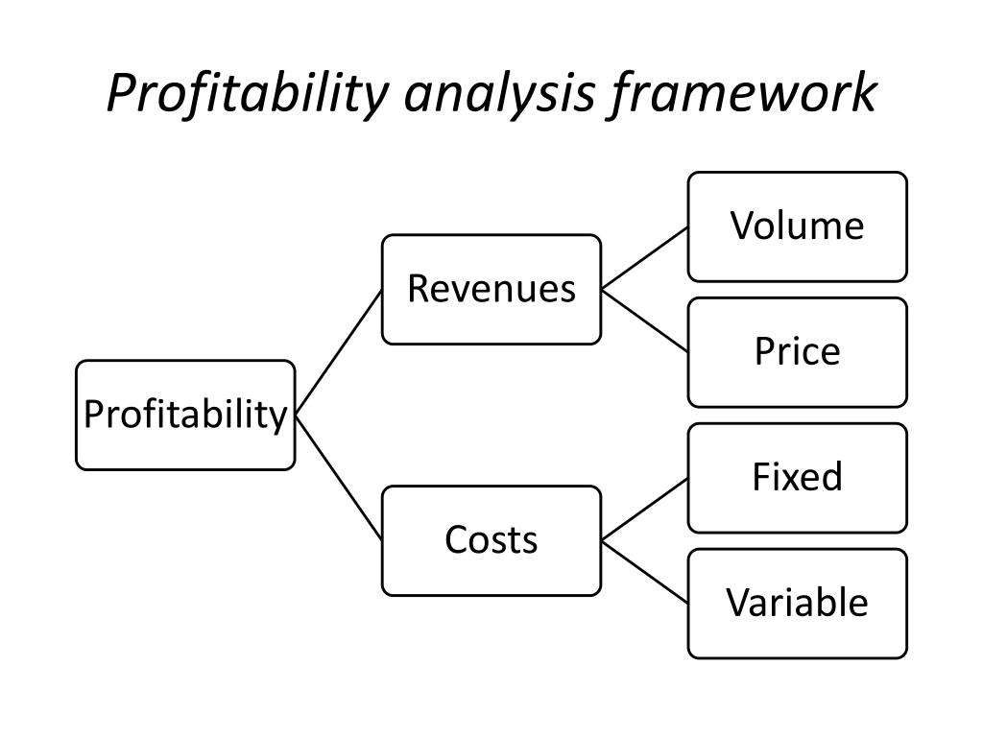
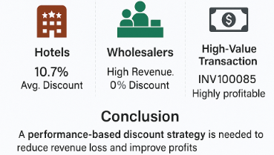
ANALYSIS 4
Profitability Analysis
Explanation
This analysis assessed profitability indirectly, since cost data was not available. It focused on evaluating the impact of discounts on revenue and identifying which transactions and customer types contributed most to net-effective earnings.
Results and Findings
Revenue Lost to Discounts was calculated using the formula: Lost Revenue = Quantity × Price × (Discount / 100)
Hotels received the highest average discount (10.7%), but their revenue contribution was relatively low, making them less profitable overall.
Wholesalers, with zero discounts, contributed the highest revenue (27.7%), making them the most profitable customer segment.
High-value transactions without discounts, such as INV100085 (Rs. 9100), were flagged as highly profitable.
Low-value transactions with no or minimal discounts, such as INV100020 (Rs. 675), offered limited profit potential.
Conclusion
Discounts do not always correlate with higher sales or profitability. A revised, performance-based discount strategy is necessary to minimize revenue leakage and maximize profit margins.

Slide 9
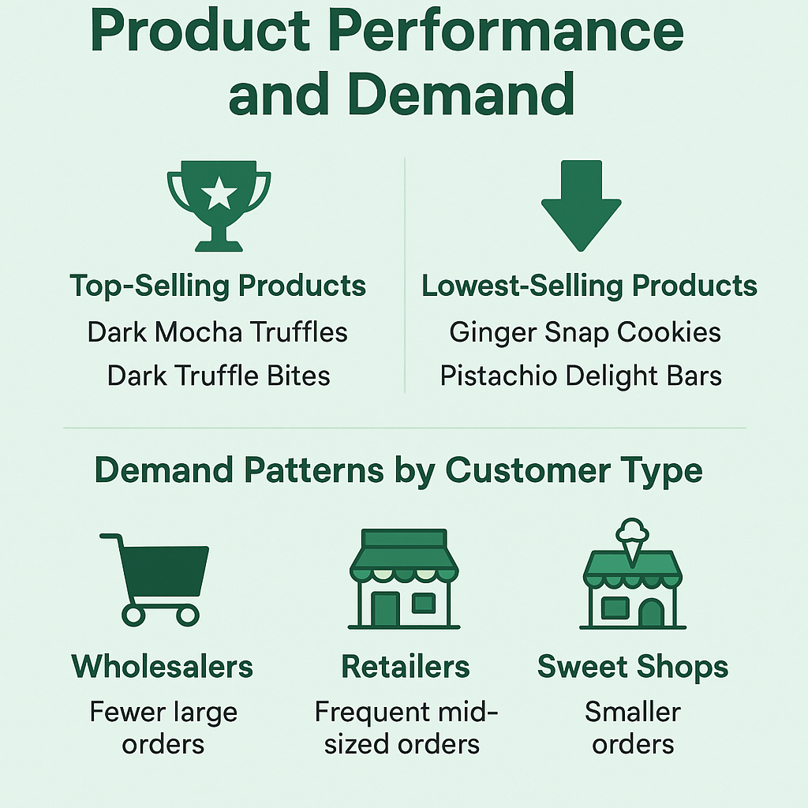
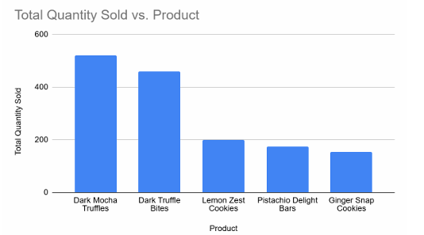
ANALYSIS 5
Product Performance and Demand
Explanation
This analysis focused on evaluating which products drive the highest sales volume and revenue, and which ones underperform. It aimed to support better inventory planning, marketing focus, and product line optimization.
Results and Findings
Dark Mocha Truffles and Dark Truffle Bites are the highest-selling products, indicating strong customer preference for premium chocolate-based items.
Ginger Snap Cookies and Pistachio Delight Bars are the lowest-selling, showing weak demand and possible overstocking.
Wholesalers place fewer but larger orders, especially for high-demand products, while Retailers make frequent, mid-sized purchases.
Demand patterns vary by customer type, which is crucial for inventory planning and targeted promotions.
Conclusion
Focusing on high-demand products and optimizing low-performing ones can significantly improve sales efficiency and inventory management.

Slide 10
Recommendations
1
Optimize Inventory Based on Product Demand
Stock more of high-demand items like Dark Mocha Truffles and Dark Truffle Bites; reduce or bundle slow-moving products like Pistachio Delight Bars.
2
Align Discounts with Customer Value
Avoid high flat-rate discounts for low-contribution segments (e.g., Hotels). Offer performance-based or tiered discounts to retain and reward high-value customers like Wholesalers.
3
Encourage Digital Payment Adoption
UPI is already the most used payment mode (39.8%). Incentivize cash-heavy buyers like Local Stores to shift to digital methods for better tracking and cash flow.
4
Automate Billing and Invoicing
Streamline UPI, Credit, and Bank Transfer invoicing to reduce manual errors, speed up transactions, and improve payment efficiency—especially for large-volume Wholesalers.
5
Launch Targeted Promotions for Low-Spending Segments
Introduce loyalty programs or combo deals for Sweet Shops and Local Stores to boost average order size and increase their contribution to overall revenue.
6
Use Time-Series Forecasting for Inventory Planning Analyze recurring revenue spikes (driven by Wholesalers) and use predictive models to prepare inventory, staffing, and marketing strategies in advance.
7
Reform Product Portfolio Regularly
Conduct quarterly reviews of product-wise sales and phase out underperforming items. Introduce limited-time or seasonal products based on customer preferences.
8
Monitor and Evaluate Discount Impact Monthly
Track revenue lost due to discounts and adjust discount strategies accordingly. Introduce loyalty points or cashback alternatives to protect margins while retaining engagement.

